Slide 1
SCSJ 3483: Web Technology
Asynchronous JavaScript

Slide 2
Synchronous Execution in JavaScript:
JavaScript default/typical behavior :- code executes line by line.
Each line of code waits for the previous one to finish before proceeding.
Referred as "blocking" because subsequent processes held up, until the current one completes.
Can lead to a predictable but potentially slow,unresponsive program, esp with tasks like file I/O, network requests, or heavy computations.
Delays in one operation can cause bottlenecks, affecting the overall performance of the application.
Commonly experienced in scenarios where tasks must be executed sequentially without concurrency.
Important to consider asynchronous programming techniques to handle time-sensitive tasks and improve the responsiveness of web applications.

Slide 3
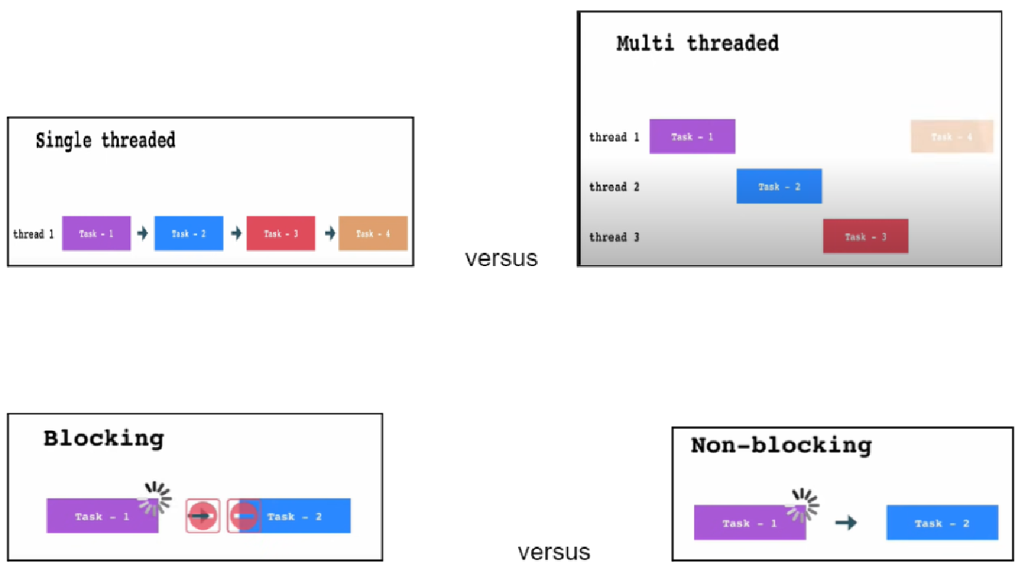
Single vs Multi-thread, Blocking vs Non-blocking

Slide 4
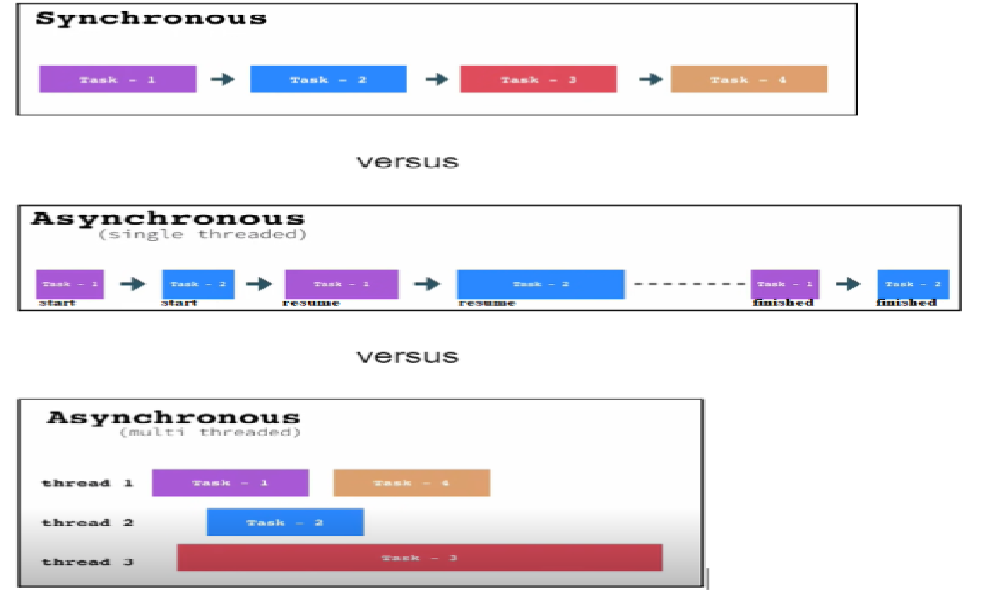
Sync vs Async(single thread) vs Async (multi-thread)

Slide 5
Asynchronous + Single Thread = Concurrent
Asynchronous + Multi Thread = Parallel
Javascript === single threaded, non-blocking, asynchronous, and concurrent

Slide 6
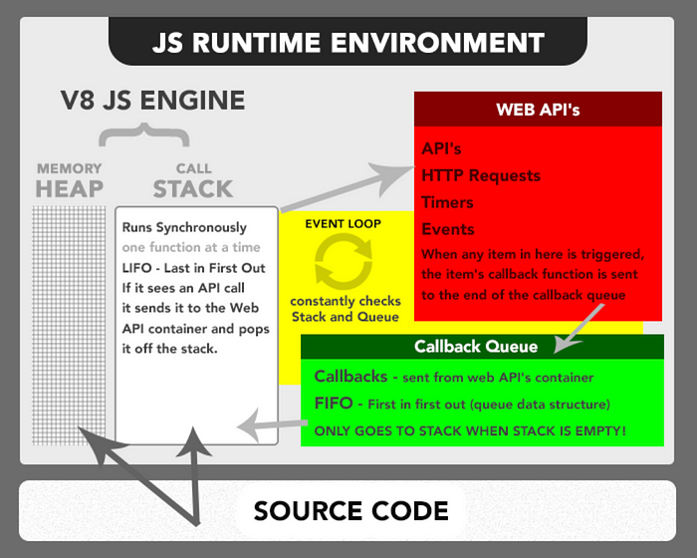
Javascript =is= single threaded, non-blocking, asynchronous, and concurrent
https://theflyingmantis.medium.com/javascript-single-threaded-non-blocking-asynchronous-concurrent-language-ffae97c57bef

Slide 7
Asynchronous Programming in JavaScript
Although by default processes in JavaScript are executed synchronously, we can make them async (ie using XHR, AJAX, Fetch, Promise, Async/Await etc...)
Async allow JavaScript to continue executing without waiting for tasks to finish.
Async are non-blocking, enabling concurrency and responsiveness.
Useful for tasks ie network requests, file I/O operations, database queries etc...
Implemented using techniques like callbacks, promises, or async/await.
Crucial for building responsive and scalable web applications.
Mastery empowers developers to create efficient and user-friendly applications.

Slide 8
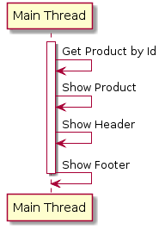
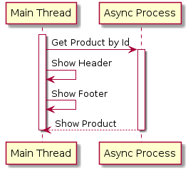
Synchronous vs Asynchronous

Slide 9
Async Options:
using XmlHttpRequest
using jQuery AJAX
using Promise
using Fetch
using Async/Await
axios
etc...

Slide 10
1. Using XmlHttpRequest
Oldest. Introduced around late 1990s by Microsoft (Internet Explorer 5) as a proprietary feature
A built-in JavaScript class that provides easy way to make HTTP requests to/receive data from web servers
Allow JavaScript to make HTTP requests asynchronously, enabling dynamic updates to web pages without reloading the entire page
Cross-Browser Compatibility: supported by all major web browsers, making it a reliable and widely compatible
More complex and verbose compared to newer alternatives like Promise, Fetch & Async/Await

Slide 11
Code Example:
function cubaXhr() {
console.log("implementasi guna xhr");
const xhr = new XMLHttpRequest();
xhr.open("get", "https://jsonplaceholder.typicode.com/users___e", true);
xhr.onload = function () {
if (xhr.status >= 200 && xhr.status < 300) {
const data = xhr.responseText;
const json_data = JSON.parse(data);
console.table(json_data);
} else {
console.info("Request failed with status: " + xhr.status);
}
};
xhr.onerror = function () {
console.log('XHR request encountered an error' + xhr.status);
};
xhr.send();
}
// Call the function
cubaXhr();

Slide 12
XmlHttpRequest : Common Methods, Properties
& Event Handlers
Method | Description
open(method, url) | Initializes the request with the specified HTTP method and URL.
send() | Sends the request to the server. Optionally includes a request body for methods like POST or PUT.
setRequestHeader() | Sets the value of an HTTP request header before sending the request.

Slide 13
XmlHttpRequest : Common Methods, Properties
& Event Handlers
Property | Description
status | Represents the HTTP status code of the response (e.g., 200 for OK, 404 for Not Found, etc.).
statusText | Represents the status message corresponding to the status code (e.g., "OK", "Not Found", etc.).
responseText | Contains the response data as a string. Useful for text-based responses (e.g., JSON, XML).
responseXML | Contains the response data as an XML document. Useful for XML-based responses.

Slide 14
XmlHttpRequest : Common Methods, Properties
& Event Handlers
Event Handler | Description
onload | Event handler triggered when the request completes successfully.
onerror | Event handler triggered when an error occurs during the request.
onreadystatechange | Event handler triggered whenever the readyState property changes.

Slide 15
List of XHR states and Description
State | Description
UNSENT (0) | The XHR object has been created, but open() method has not been called yet.
OPENED (1) | The XHR object has been created, and open() method has been called. The request is not sent yet.
HEADERS_RECEIVED (2) | The send() method has been called, and headers and status are available.
LOADING (3) | The response body is being received.
DONE (4) | The operation is complete.

Slide 16
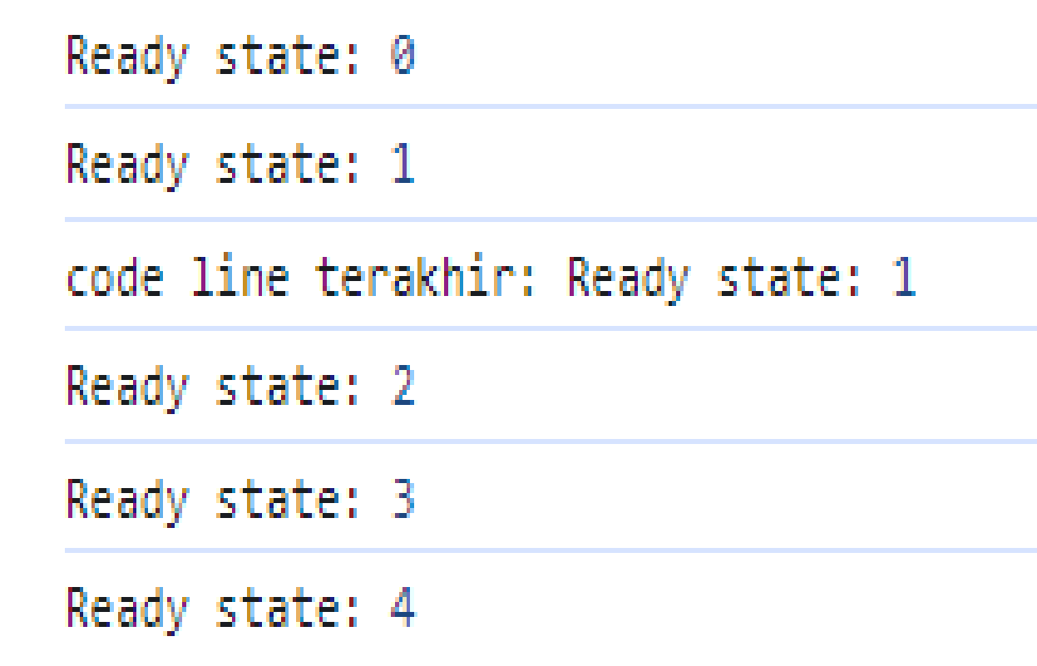
Code example - readyState
const xhr = new XMLHttpRequest();
console.log('Ready state:', xhr.readyState);
// Define the onreadystatechange event handler
xhr.onreadystatechange = function () {
console.log('Ready state:', xhr.readyState);
};
// Open the XHR request
xhr.open('GET', 'https://jsonplaceholder.typicode.com/posts/1');
// Send the XHR request
xhr.send();
console.log('code line terakhir: Ready state:', xhr.readyState);

Slide 17
2. Using jQuery AJAX
jQuery AJAX has been part of the jQuery library since its early versions (jQuery introduced in 2006)
Methods in jQuery library to simplify async HTTP requests in JavaScript.
Abstracts away complexities of XHR, provides simpler and consistent way for making Ajax requests and handle responses in a consistent manner across different browsers.
Widely used in web development for many years before newer native alternatives became available

Slide 18
jQuery General Syntax:
console.log("jQuery Start");
$.ajax({
url: 'https://api.example.com/data', // URL of the resource to request
method: 'GET', // HTTP method (GET, POST, PUT, DELETE, etc.)
dataType: 'json', // Expected data type of the response (json,xml,html, text etc)
success: function (data) { // Success callback function
console.log('Success:', data); // Log the response data to the console
},
error: function (xhr, status, error) { // Error callback function
console.error('Error:', error); // Log an error message to the console
}
});
console.log("jQuery End");

Slide 19
Code Example: (Get all users from jsonplaceholder)
console.info("guna jquery ajax");
$(document).ready(function () {
function cubaXhr() {
$.ajax({
url: 'https://jsonplaceholder.typicode.com/users',
method: 'GET',
dataType: 'json',
success: function (data) {
console.table(data);
},
error: function (xhr, status, error) {
console.error(`Request failed with status : ${xhr.status}`);
}
});
}
// Call the function
cubaXhr();
});

Slide 20
Important Options and Methods in jQuery Ajax:
 | Option/ Method | Description
1 | url | Specifies the URL to which the Ajax request should be sent.
2 | method | Specifies the HTTP method to be used for the request (e.g., "GET", "POST", “PATCH”, "PUT", "DELETE").
3 | data | Specifies the data to be sent to the server. It can be a query string or an object.
4 | dataType | Specifies the expected data type of the response from the server (e.g., "json", "xml", "html", "text").
5 | contentType | Specifies the Content-Type header of the request. It is used when sending data to the server.
7 | success | A callback function to be executed if the request is successful. It receives the response data, status, and the jqXHR object as arguments.
8 | error | A callback function to be executed if the request fails. It receives the jqXHR object, the status error message, and an optional exception object as arguments.

Slide 21
// Code Example: jQuery AJAX, POST user to backend
var userData = {name: "Johan Dolah", username: "johandolah", email: "jdolah@gmail.com"};
// Send POST request to create a new user
$.ajax({
url: "https://jsonplaceholder.typicode.com/users",
method: "POST",
contentType: "application/json",
data: JSON.stringify(userData),
success: function(response) {
console.log(`New user created: ${response} with generated id = ${response.id}`);
},
error: function(xhr, status, error) {
console.error("Error creating user:", error);
}
});
});

Slide 22
// Code Example: jQuery AJAX, PATCH user to backend
var userBaru = {name: "Johana Baru", email: "joh_bar@gmail.com" };
// User ID to be updated
var userId = 1; // Example user ID bagi user Johan
// Send PATCH request to update the user
$.ajax({
url: "https://jsonplaceholder.typicode.com/users/" + userId,
method: "PATCH",
contentType: "application/json",
data: JSON.stringify(userBaru),
success: function(response) {
console.info("User updated:", response);
},
error: function(xhr, status, error) {
console.error("Error updating user:", error);
} }); }); });

Slide 23
// Code Example: jQuery AJAX, DELETE user di backend
// User ID to be deleted
var userId = 1;
// Send DELETE request to remove the user
$.ajax({
url: "https://jsonplaceholder.typicode.com/users/" + userId,
method: "DELETE",
success: function(response) {
console.log("User deleted:", response);
},
error: function(xhr, status, error) {
console.error("Error deleting user:", error);
}
});
});
});;

Slide 24
3. using Promise
Introduced as part of the ECMAScript 6 (ES6) specification in 2015
Promise - is an object that represents the eventual completion or failure of an asynchronous operation, and its resulting value
It allows us to handle asynchronous operations more easily and elegantly compared to traditional callback-based approach
Gained popularity due to simplicity and improved error handling.
Became preferred method for handling asynchronous code in modern JavaScript development.

Slide 25
promise : general syntax
const promise = new Promise(function(resolve, reject) {
// Do some asynchronous operation
// If the operation is successful, call resolve with the result
// If an error occurs, call reject with an error object or message
});
example:
console.info("implementasi guna promise");
const promise = new Promise(function (resolve, reject) {
// Simulasikan async guna setTimeout. dlm real sit, buat request ke jsonplaceholder
setTimeout(function () {
const randomNumber = Math.random(); //generate 1 random number
if (randomNumber > 0.5) { //jika nilainya >0.5
resolve(randomNumber); // Resolve the promise with the random number
//dlm real situation, resolve dengan json data users
} else {
reject(Error('Random number is less than 0.5')); // Create object from Reject
}
}, 5000); // pause 5 saat sblum resolving or rejecting the promise
});

Slide 26
Promise: State, Status and Transition
State | Description
Pending | The initial state of a promise, waiting for resolution.
Fulfilled | The promise has been successfully resolved with a value.
Rejected | The promise has been rejected due to an error or failure.
Status | Description
Resolved | A general term referring to a promise that has been settled, either fulfilled or rejected.
Settled | Another term for a promise that has been resolved (either fulfilled or rejected). It's often used interchangeably.
Transition | Description
Pending → Fulfilled | Transition occurs when the operation represented by the promise is successfully completed, and the promise is fulfilled with a value.
Pending → Rejected | Transition occurs when the operation represented by the promise encounters an error or is unsuccessful, and the promise is rejected with a reason.

Slide 27
4. Using Fetch
Introduced as part of the ECMAScript 6 (ES6) specification alongside Promises in 2015
Alternative to XHR for making HTTP requests.
Simplified the process of making asynchronous requests by returning Promises, making it easier to handle responses and errors. It gradually replaced XHR in many web applications
Several important methods and properties associated with the fetch():
  4. 1. fetch(url, options): Initiates a request to the specified URL with optional settings
  Example:
    fetch("https://api.example.com/data", {
    method: "GET",
    headers: {
    "Content-Type": "application/json"
    } });

Slide 28
4. Fetch (cont...)
3.2 Response: Represents the response to an HTTP request. It provides several methods and properties to access the response data and metadata
  response.json(): Parses the response body as JSON and returns a promise containing the parsed data.
  response.text(): Reads the response body as text and returns a promise containing the text data.
  response.status: Returns the status code of the response (e.g., 200 for OK, 404 for Not Found).
  response.ok: Returns a boolean indicating whether the response was successful (status code in the range 200-299).

Slide 29
4. Fetch (cont...)
3.3 Request: Represents an HTTP request. It allows you to customize the request method, headers, body, and other options.
  Example:
  const request = new Request("https://api.example.com/data", {
  method: "POST",
  headers: {
  "Content-Type": "application/json"
  },
  body: JSON.stringify({ key: "value" })
  });
  fetch(request)
  .then(response => response.json())
  .then(data => console.log(data))
  .catch(error => console.error(error));

Slide 30
Fetch
Example:
  // Fetch users from JSONPlaceholder API
  fetch( 'https://jsonplaceholder.typicode.com/users')
  .then(response => {
  if (!response.ok) {
  throw new Error('Failed to fetch users');
  }
  return response.json(); // Parse the response body as JSON
  })
  .then(users => {
  console.log('Users:', users); // Log the fetched users
  })
  .catch(error => {
  console.error('Error:', error); // Log any errors
  });
General Syntax:
  fetch(url, config)
  .then(response => {
  // Handle the response
  })
  .catch(error => {
  // Handle any errors
  });
  Example:

Slide 31
Another example
function cubaFetchPost() {
// Define user data as a JavaScript object
console.info('cuba fetch post new user')
const user = {
name: 'Siti Aminah,
email: siam@gmail.com'
};
// Fetch data from JSONPlaceholder API using specified options
fetch('https://jsonplaceholder.typicode.com/users', {
method: 'POST', // HTTP method
headers: {
'Content-Type': 'application/json' // Specify content type
},
body: JSON.stringify(user) // Request body (for POST requests)
})
.then(response => {
if (!response.ok) {
console.log('errer: '+response.status)
throw new Error('Failed to fetch data');
}
console.log('status: '+response.status)
return response.json(); // Parse the response body as JSON
})
.then(data => {
console.log('Data:', data); // Log the fetched data
})
.catch(error => {
console.error('Error:', error); // Log any errors
});
};

Slide 32
5. Using Async/Await
Introduced as part of the ECMAScript 2017 (ES8) specification.
Built upon Promises to provide a more readable and synchronous-like way to write asynchronous code.
Async/await quickly became popular due to its ability to make asynchronous code look and behave more like synchronous code.
Simplified error handling and made complex asynchronous operations easier to understand
modern JavaScript feature that allows you to work with asynchronous code in a more synchronous and readable manner
provides a syntactic sugar on top of Promises, making asynchronous code easier to write and understand

Slide 33
x.1. Async Function
function that operates asynchronously via the event loop, allowing non-blocking behavior.
It is defined using the async keyword before the function declaration
example:
  async function fetchData() {
  // Asynchronous operations here
  }

Slide 34
x.2. Await Keyword:
await keyword is used inside an async function to pause the execution of the function until a Promise is resolved, effectively waiting for the asynchronous operation to complete.
It can only be used within async functions.
example:
  async function fetchData() {
  const result = await someAsyncOperation();
  // Code here will wait until someAsyncOperation completes
  }

Slide 35
x.3. Error Handling:
Errors in async functions can be handled using try...catch blocks, similar to synchronous code.
example:
  async function fetchData() {
  try {
  const result = await someAsyncOperation();
  // Code here will wait until someAsyncOperation completes
  } catch (error) {
  console.error('Error:', error);
  }
  }

Slide 36
x.4. Returning Values:
Async functions can return Promises. If a value is returned from an async function, it is automatically wrapped in a resolved Promise.
example:
  async function fetchData() {
  const result = await someAsyncOperation();
  return result;
  }
  // Usage
  fetchData().then(data => {
  console.log('Data:', data);
  });

Slide 37
Code Example
// Async/Await example
console.log("Start");
async function asyncExample() {
try {
const data = await fetch("https://jsonplaceholder.typicode.com/users");
const jsonData = await data.json();
console.log("Async/Await data:", data);
console.log("json data:", jsonData);
} catch (error) {
console.error("Async/Await error:", error);
}
}
asyncExample();
console.log("End");

